Slide 1
Object-Oriented Programming in JAVA
Satpute Arshita Harihar
September 10, 2023

Slide 2
Agenda
Overview of OOP
Four Pillars of OOP
Classes and Objects
Inheritance
Polymorphism
Encapsulation
Abstraction
Conclusion

Slide 3
What is OOP?
Definition:
OOP is an object-oriented programming technique that combines data and instructions for processing that data into an object that can be used within the program.
Object-oriented programming provides concepts that help model complicated real-world systems into manageable software solutions.
Advantages: Reusability, Modularity, Extensibility, Maintainability.

Slide 4
Four Pillars of OOPs
Encapsulation
Abstraction
Polymorphism
Inheritance

Slide 5
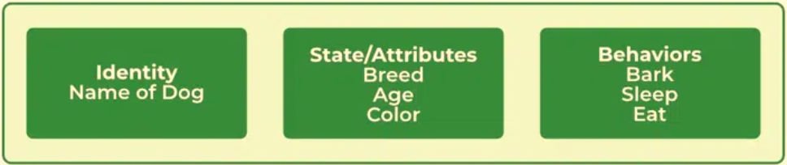
CLASSES & OBJECTS
A class in Java is a set of objects that shares common characteristics/ behavior and common properties/ attributes. It is a user-defined blueprint or prototype from which objects are created.
An object in Java is a basic unit of Object-Oriented Programming and represents real-life entities. Objects are the instances of a class that are created to use the attributes and methods of a class. A typical Java program creates many objects, which as you know, interact by invoking methods.

Slide 6
INHERITANCE
A class that inherits from another class can reuse the methods and fields of that class.
It is the mechanism in Java by which one class is allowed to inherit another class's features(fields and methods). In Java, Inheritance means creating new classes based on existing ones.
Example:
import java.io.*;
class Employee {
int salary = 60000;
}
class Engineer extends Employee {
int benefits = 10000;
}
class Main {
public static void main(String args[])
{
Engineer E1 = new Engineer();
System.out.println("Salary : " + E1.salary);
System.out.println("Benefits : " +
E1.benefits);
}
}
Output:
Salary: 60000
Benefits: 10000
Super-Class
Employee
Extends
Derived-Class
Engineer

Slide 7

POLYMORPHISM
The ability of a message to be displayed in more than one form.
Polymorphism allows you to define one interface and have multiple implementations. The word “poly” means many and “morphs” means forms, so it means many forms.
Example:
class Animal {
void makeSound() {
System.out.println("Some generic sound");
}
}
class Dog extends Animal {
void makeSound() {
System.out.println("Woof!");
}
}
class Cat extends Animal {
void makeSound() {
System.out.println("Meow!");
}
}
public class PolymorphismExample {
public static void main(String[] args) {
Animal animal1 = new Dog();
Animal animal2 = new Cat();
animal1.makeSound();
animal2.makeSound();
}
}
Output:
Woof!
Meow!

Slide 8
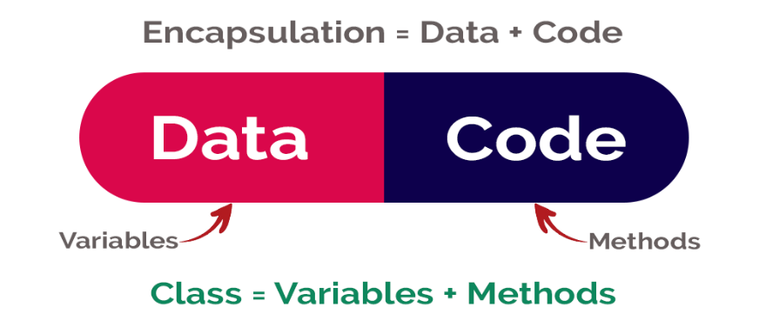
ENCAPSULATION
Process of wrapping code and data together into a single unit.
Encapsulation is a way of hiding the implementation details of a class from outside access and only exposing a public interface that can be used to interact with the class.
Example:
class Person {
private String name;
private int age;
public String getName() {
return name;
}
public void setName(String name){
this.name = name;
}
}
public class Main {
public static void main(String[] args)
{
Person person = new Person();
person.setName("John");
System.out.println("Name: " + person.getName());
}
}
Output:
Name: John

Slide 9
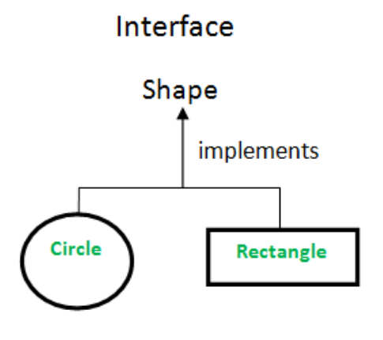
ABSTRACTION
Example:
Interface Shape {
double calculateArea();
}
class Circle implements Shape {
private double radius;
public Circle(double radius) {
this.radius = radius;
}
public double calculateArea() {
return Math.PI * radius * radius;
}
}
public class AbstractionExample {
public static void main(String[] args) {
System.out.println(new Circle(5).calculateArea());
}
}
Output: 78.53981633974483
Process of identifying only the required characteristics of an object ignoring the irrelevant details.
Simplifying complex systems by modeling classes based on the essential properties and behaviors.

Slide 10
CONCLUSION
In conclusion, understanding and applying the Four Pillars of OOP – Encapsulation, Inheritance, Polymorphism, and Abstraction – is crucial for building scalable, maintainable, and modular software. The encapsulation of data, inheritance for code reuse, polymorphism for flexibility, and abstraction for simplification collectively contribute to the robustness of object-oriented programming. Stress the importance of these principles in enhancing scalability, easing maintenance, and promoting modularity in software development. Encourage continuous exploration and practical application of Java OOP concepts through hands-on exercises, personal projects, and community engagement. Mastery of OOP not only elevates programming skills but also opens doors to a dynamic and collaborative developer community.

Slide 11
FILE HANDLING IN JAVA

Slide 12
Agenda
Introduction to File Handling
Types of Files in Java
File Classes in Java
Reading from Text Files
Writing to Text Files
Reading from Binary Files
Writing to Binary Files
Best Practices
Conclusion

Slide 13
Introduction to File Handling in Java
File handling is the manipulation of files, encompassing the reading and writing of data, using Java programming. It provides a mechanism to interact with files, enabling tasks such as storing, retrieving, and managing data.
File handling is fundamental to Java programming as it facilitates the seamless storage and retrieval of information. Whether dealing with configuration files, databases, or user input, the ability to read from and write to files is crucial for applications to persistently store data, ensuring its availability across sessions. Effective file handling is a cornerstone in developing applications that involve data storage, retrieval, and manipulation.

Slide 14
Types of Files in Java
Text Files:
Plain text files containing readable characters.
Examples include .txt files.
Binary Files:
Contain non-textual data, such as images, videos, or any format not composed of plain text.
Examples include .jpg, .mp3, etc.

Slide 15
File Classes in Java
1. File Class:
Represents a file or directory path.
Allows querying file information, such as existence, size, and permissions.
FileInputStream and FileOutputStream:
Used for reading and writing bytes to and from files.
Ideal for binary data.
FileReader and FileWriter:
Used for reading and writing characters to and from files.
Suitable for text data.
BufferedReader and BufferedWriter:
Provide buffered reading and writing, enhancing performance.
Efficient for handling large amounts of data.

Slide 16
Reading from Text Files
Writing to Text Files
To read data from text files in Java, we use classes like FileReader and BufferedReader. Here's an example:
To write data to text files, we use classes like FileWriter and BufferedWriter. Here's an example:
try (BufferedReader br = new BufferedReader(new FileReader("example.txt"))) {
String line;
while ((line = br.readLine()) != null) {
System.out.println(line);
}
} catch (IOException e) {
e.printStackTrace();
}
try (BufferedWriter bw = new BufferedWriter(new FileWriter("output.txt"))) {
bw.write("Hello, Java File Handling!");
} catch (IOException e) {
e.printStackTrace();
}
This code reads each line from the "example.txt" file and prints it to the console. Notice the use of try-with-resources to automatically close the resources.
This code writes the specified text to the "output.txt" file. Again, try-with-resources ensures proper resource management.

Slide 17
Reading from Binary Files
Writing to Binary Files
Reading from binary files involves using classes like FileInputStream. Here's a basic example:
To write data to binary files, we use classes like FileOutputStream. Here's an example:
try (FileInputStream fis = new FileInputStream("image.jpg")) {
int data;
while ((data = fis.read()) != -1) {
// Process the byte data
}
} catch (IOException e) {
e.printStackTrace();
}
try (FileOutputStream fos = new FileOutputStream("output.jpg")) {
byte[] data = // your byte array
fos.write(data);
} catch (IOException e) {
e.printStackTrace();
}
This code snippet reads a binary file (in this case, an image file) byte by byte. Binary files contain non-textual data, so reading them as bytes is a common approach.
In this code, a FileOutputStream is used to write a byte array to a binary file, such as an image file. Ensure that you properly handle exceptions and provide the correct byte data according to the file format.

Slide 18
Best Practices
Use try-with-resources:
Utilize the try-with-resources statement to ensure that resources (like file streams) are closed properly.
Proper Exception Handling:
Implement comprehensive exception handling to manage potential errors during file operations.
try (BufferedReader br = new BufferedReader(new FileReader("example.txt"))) {
// File operations
}
catch (IOException e) {
e.printStackTrace();
}

Slide 19
Best Practices
3. Check File Existence:
Before performing file operations, check whether the file exists to avoid runtime errors.
4. Use Buffered Readers/Writers:
Employ BufferedReader and BufferedWriter for efficient reading and writing, especially when dealing with large files.
5. Understand File Types:
Be aware of whether you are working with text or binary files, as this influences the choice of file handling classes.
File file = new File("example.txt");
if (file.exists()) {
// Perform file operations
}
else {
System.out.println("File not found!");
}

Slide 20
Conclusion
File handling in Java is a fundamental aspect of many applications, allowing for data storage, retrieval, and manipulation.
We covered:
Types of Files:
Text Files: Plain text files with readable characters.
Binary Files: Contain non-textual data like images or videos.
File Classes in Java:
File, FileInputStream, FileOutputStream, FileReader, FileWriter, BufferedReader, and BufferedWriter.
Reading and Writing Operations:
Reading from and writing to both text and binary files.
Best Practices:
Using try-with-resources, proper exception handling, checking file existence, and using buffered readers/writers.
Understanding these concepts and practices is crucial for developing reliable and efficient file-handling functionality in Java applications. As you continue to explore Java file handling, remember to adapt these principles to your specific use cases.

Slide 21
Thank You
Satpute Arshita Harihar
satputearshita@gmail.com

